Slide 1
The Hangover
Bryce, Arya, Soham, James
Notes:
Bryce - Intro

Slide 2
Table of Contents
01 Story
02 Location
03 Puzzles
04 Connection 1
05 Connection 2
06 Technology
Notes:
Soham

Slide 3
Story
01
We will introduce the premise of our story
Notes:
Story slides - Soham

Slide 4
The Start
Noah & Felix got in a fight whilst clubbing
Felix leaves the club and roams out into Alexanderplatz in a drunken stupor
Noah parties for the next few hours & forgets about his friend
Noah needs to find his very drunk friend the next morning

Slide 5
The Plot
Felix stole Noah’s wallet
The Journey
Noah tries to call and text Felix, but his phone is dead.
Noah discovers a Life360 snapshot with 6 different locations, but the trail goes cold after that …
Felix leads Noah on a wild goose chase around Alexanderplatz.
With every clue comes an answer to unlock the next puzzle.
An exercise of patience & determination

Slide 6
Location
02
7 locations throughout Alexanderplatz
Notes:
Location Slides- James & Arya

Slide 7
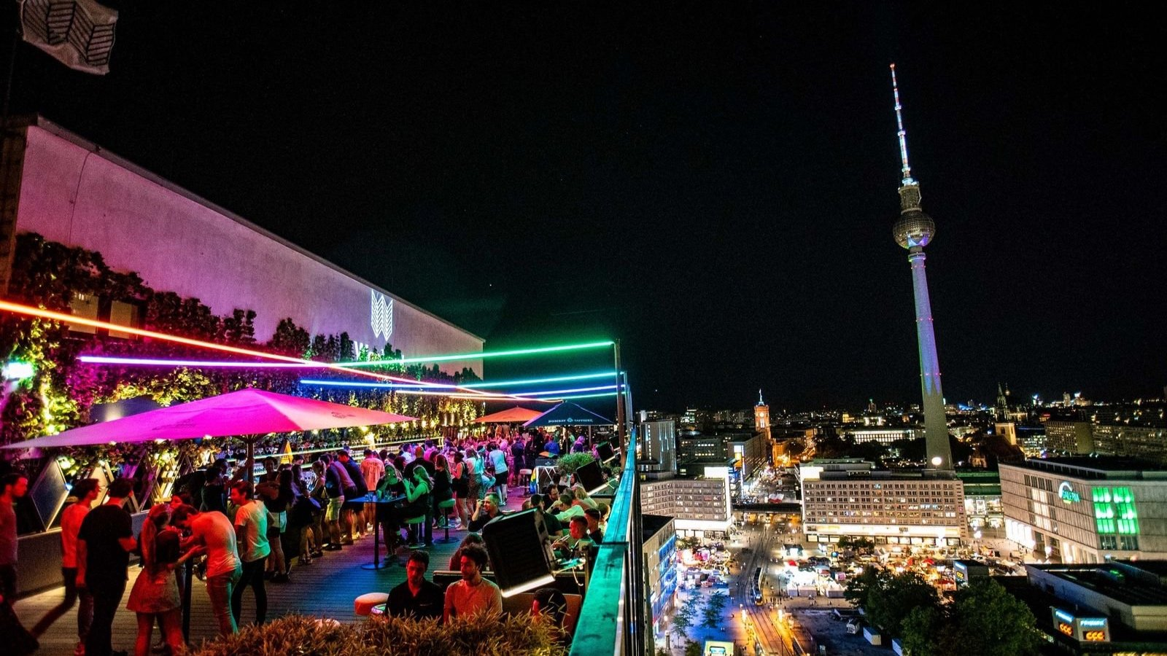
House of Weekend
The House of Weekend is where we start out story. Roleplay as Noah after a night out

Slide 8
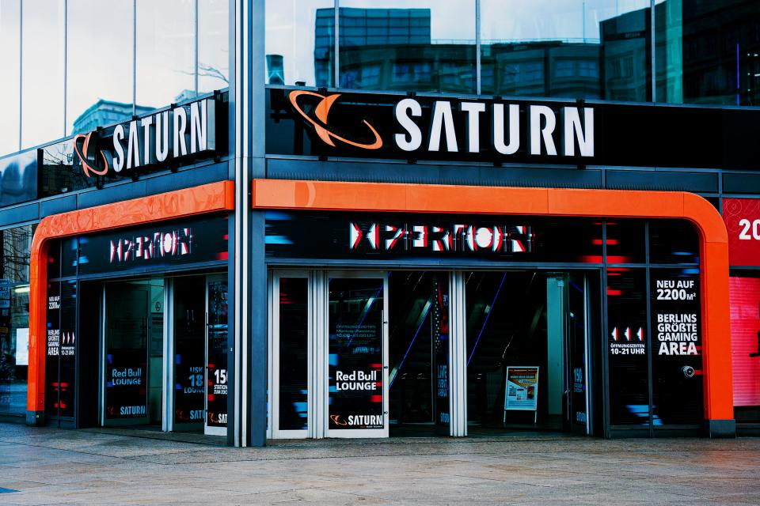
Saturn Electronics
Outside of the Saturn Electronics store is where you will find the next answer to the puzzle

Slide 9
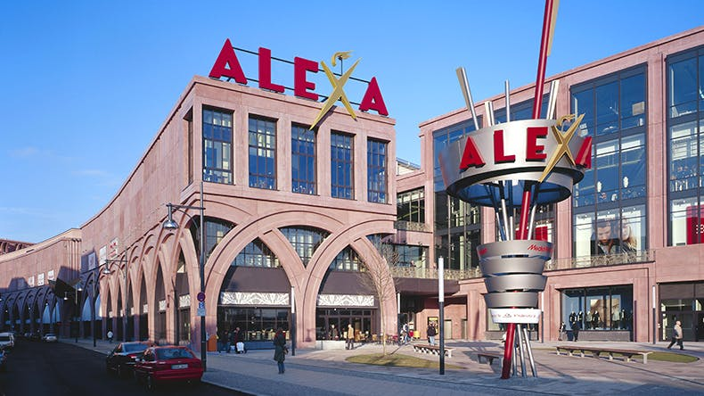
Alexa Mall
Head to Alexa Mall to a bookstore inside the mall.

Slide 10
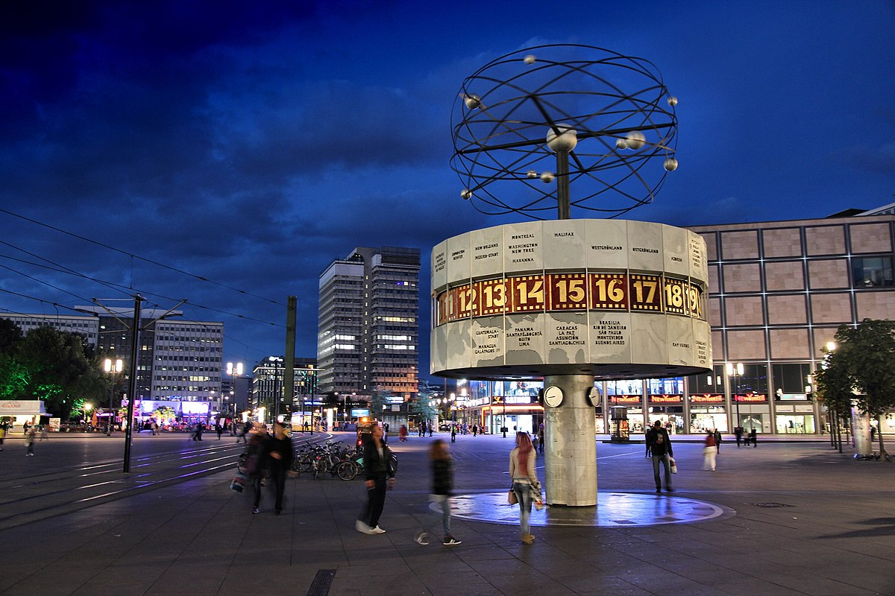
World Clock
The World Clock holds the key to the next puzzle. Pay attention to everything that Felix says here!

Slide 11
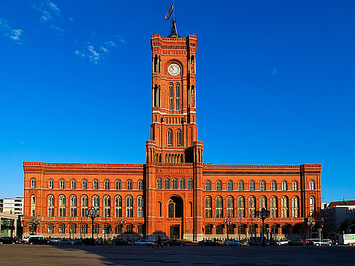
Rotes Rathaus
This clue is multifaceted. Be careful! You might miss the answer.

Slide 12
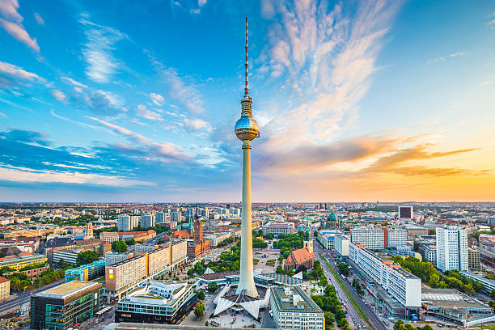
TV Tower
The TV Tower is where

Slide 13
Puzzles
03
The main locative component of The Hangover

Slide 14
Puzzles incorporate various locations in Alexanderplatz
Clues hint to various alphanumeric passwords.
Puzzle answers unlock the next puzzle
Puzzle dialogue simulates a “drunk” Felix trolling his friend Noah for his wallet
Locations are extremely diverse
Past & Present
Notes:
Arya

Slide 15
Turner - liminality in performances
04
Liminality in performances – Transition spaces where real and game worlds merge
Notes:
James
Transition spaces where real and game worlds merge.
Ingress: Real-world locations become game spaces.
Overlapping Real Life and Game
Shared Locations: Players engage in game activities at real places.
Examples: Historical sites, urban environments.
Anomalies and Role-Playing
Anomalies: In-game events with actors interacting with players.
Immersion: Players role-play, enhancing game realism.

Slide 16
Sutton-Smith - Virtual Worlds as Play
05
Blending locations with puzzles
Notes:
Soham
Sutton-Smith emphasized the importance of play as a form of storytelling and exploration, often involving imaginary realms. In a locative game, players engage with the real world while interacting with digital elements that can transform physical spaces into playful, narrative-rich environments.
The story of Felix and Noah creates an imagined reality that players enter. The game uses real-world Berlin as a canvas, transforming familiar locations into sites of narrative significance and puzzle-solving.
Players experience Berlin through the perspectives of Felix and Noah, exploring their conflicts, emotions, and motivations. This character-driven approach adds depth to the "play world," aligning with Sutton-Smith's idea of narrative as a fundamental element of play.

Slide 17
Technology
06

Slide 18
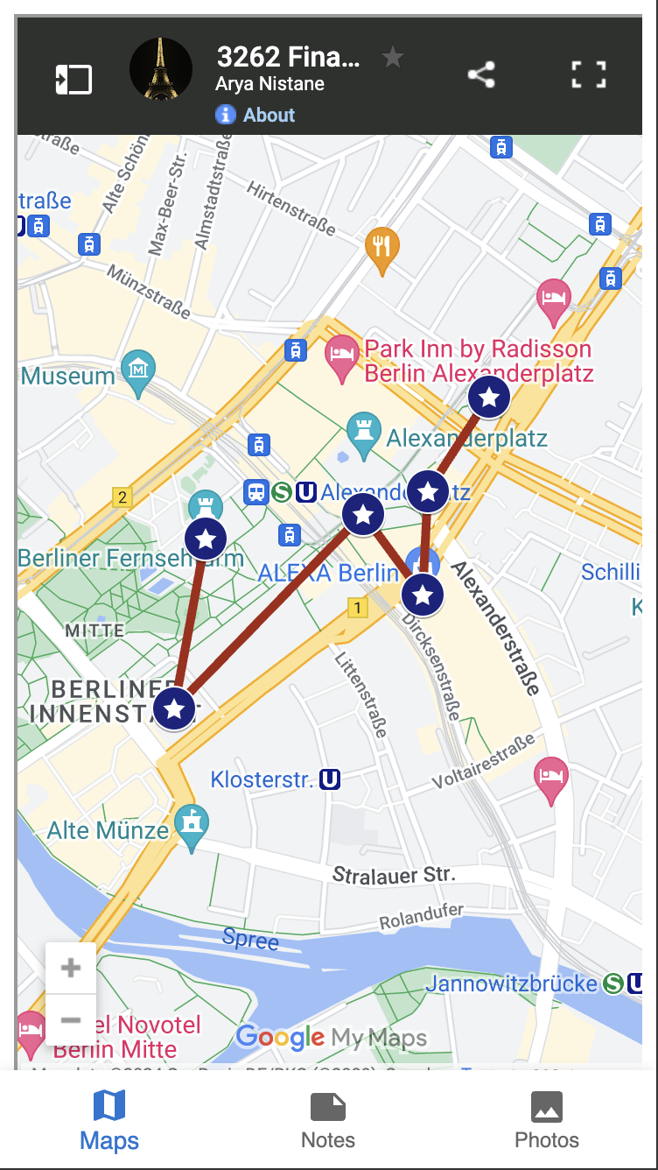
The Map
Notes:
Bryce

Slide 19
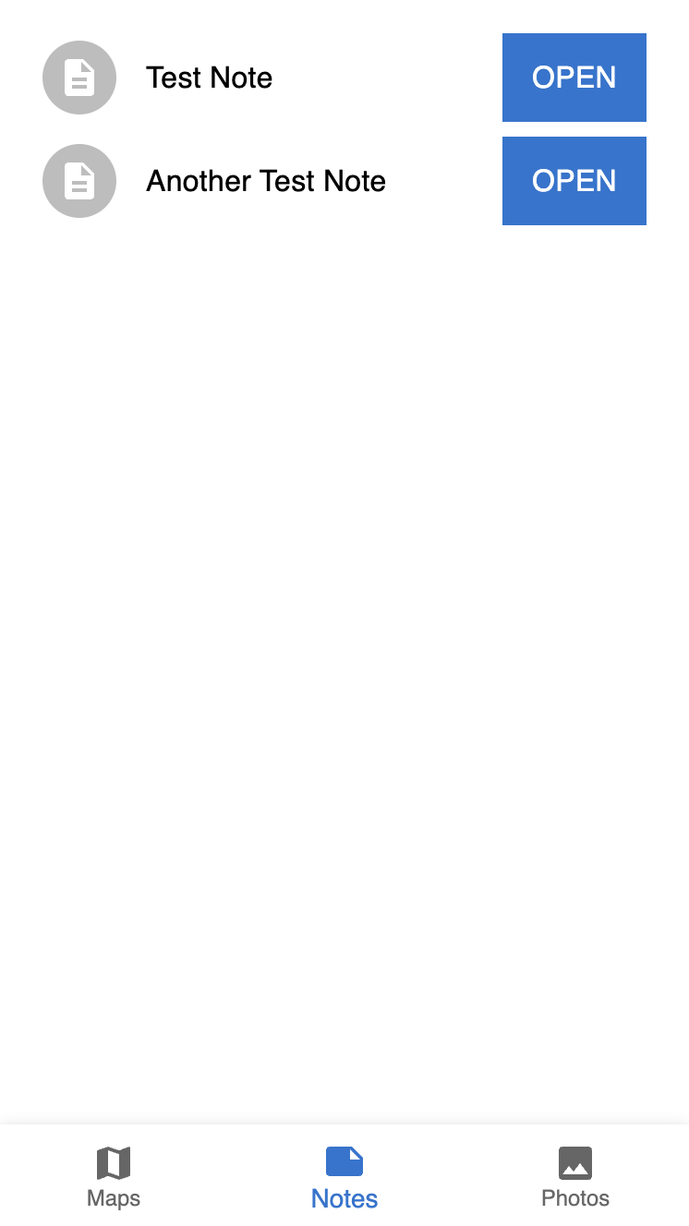
The Notes
Notes:
Bryce

